Slide 1
Federated Learning for 6G Networks Navigating Privacy Benefits and Challenges

Slide 2
Contents of the presentation
Implementation
  1. Data Description
  2. EDA Explanation
  3. Preprocessing steps
  Model Implementation
1. Algorithm Definition
2. working Process
3. Results from Algorithm
  Performance comparison
  Output Screen
  Future Scope
  Conclusion
  refferences
Project Description
Problem Statement
Objective
Scope
Literature Survey
Significant
Existing and Proposed System
Project flow
Resource Requirements
Architecture
UMLS
Research Gap analysis
Implementation

Slide 3
Project Description
The next generation of wireless communication, 6G, is expected to interconnect billions of ultra‑intelligent devices and deliver sub‑millisecond latency for immersive applications such as holographic telepresence and autonomous mobility. Traditional cloud‑centric AI pipelines cannot scale to this setting because continuous raw‑data transfer overloads backhaul links and exposes sensitive user information. To address this gap, our project implements a federated‑learning (FL) framework in which edge devices train models locally and share only encrypted weight updates with a coordinating server. We prototype the concept in a Flask web application that allows users to register, upload sample beamforming datasets, choose among six candidate algorithms (Random Forest, FNN, CNN, MLP, XGBoost, Decision Tree), and receive real‑time prediction feedback on 6G beam‑forming success

Slide 4
Project Description
The back‑end simulates an FL round by averaging locally derived model parameters, demonstrating up to 100 % accuracy for tree‑based ensembles while preserving data sovereignty. We also quantify communication savings, latency reductions, and resistance to data‑reconstruction attacks compared with centralized training. Nonetheless, challenges emerge: non‑IID data distributions, straggler devices, model poisoning, and the need for fine‑grained incentive mechanisms. Our findings suggest that integrating differential privacy, secure aggregation, and blockchain‑based audit trails will be crucial for trustworthy, large‑scale FL deployment in 6G ecosystems.
Keywords: 6G, Federated Learning, Edge AI, Privacy‑Preserving Training, Beamforming Prediction, Secure Aggregation

Slide 5
Problem Statement
With the rise of 6G communication systems, there is a growing need for real-time intelligence at the network edge while ensuring data privacy, low latency, and minimal network congestion. Traditional centralized AI models require large-scale raw data transfer to cloud servers, creating privacy risks, increased latency, and network bottlenecks, especially in ultra-dense and delay-sensitive 6G scenarios. Additionally, sending sensitive data like beamforming parameters across networks poses serious compliance and ethical challenges. These factors render centralized architectures unsuitable for the demands of 6G. The problem lies in developing an AI-based solution that maintains performance without compromising data ownership or overloading communication links. This project addresses this problem by designing a Federated Learning-based solution where model training occurs on-device, and only encrypted updates are shared with a central aggregator. This approach drastically reduces privacy exposure and network usage while maintaining high model accuracy, scalability, and adaptability in heterogeneous network environments.

Slide 6
Objective of the Project
The objective of this project is to design and implement a privacy-preserving, decentralized machine learning system tailored specifically for the demanding environment of 6G networks. With the help of Federated Learning (FL), the system enables multiple edge devices to collaboratively train machine learning models without sharing their raw data, thereby preserving user privacy and reducing network congestion. The project involves developing a secure and interactive web application using Flask, where users can register, upload beamforming datasets, select from multiple machine learning algorithms, and receive real-time prediction results. The backend simulates FL rounds by averaging encrypted model weight updates from virtual edge clients. Additionally, the project evaluates model performance, communication savings, and latency improvements when compared to traditional centralized AI models. It also aims to explore potential challenges such as non-IID data, straggler devices, and model poisoning attacks. Ultimately, the system demonstrates the feasibility and benefits of Federated Learning for future 6G-enabled intelligent infrastructure.

Slide 7
Scope
This project focuses on developing and validating a prototype FL system suitable for next-generation 6G networks, with an emphasis on privacy, performance, and scalability. The scope includes building a complete pipeline: user registration and authentication, dataset upload interface, machine learning model selection, and a backend capable of simulating federated model aggregation. Six algorithms—including Random Forest, Decision Tree, FNN, CNN, MLP, and XGBoost—are integrated for evaluation. The prototype will assess beamforming success predictions using edge-based model training while highlighting network load reductions and data security benefits. The system does not rely on real distributed edge hardware but simulates FL behavior to demonstrate core functionality. Key out-of-scope areas include real-time deployment on physical edge networks, hardware acceleration (e.g., GPU), and advanced encryption schemes like homomorphic encryption. However, future extensions can include blockchain integration and secure multiparty computation. This project lays a foundational framework for practical FL in 6G telecom applications.

Slide 8
Literature Survey
Year | Author(s) | Title | Key Contributions
2023 | Xu et al. | Blockchain-empowered Federated Learning for 6G | Combines FL with blockchain for traceability and trust in 6G; emphasizes audit trails and secure updates
2022 | Yang et al. | Federated Learning for Edge Intelligence in 6G Networks | Overview of enabling FL in 6G, covers latency, non-IID issues, and model convergence
2021 | Luong et al. | Federated Learning in 6G: A Survey on Enabling Technologies | In-depth survey on FL challenges and architectures in 6G ecosystems
2021 | Wang et al. | Adaptive Federated Learning in Resource Constrained Edge Systems | Proposes adaptive scheduling strategies to handle client heterogeneity and stragglers
2021 | Bonawitz et al. | Practical Secure Aggregation for Privacy-Preserving ML | Introduces secure aggregation protocols enabling privacy-preserving global model updates
2020 | Zhang et al. | Federated Learning for Edge Intelligence: Applications and Challenges | Highlights edge-based FL deployment, communication savings, and scalability

Slide 9
Year | Author(s) | Title | Key Contributions
2020 | Zhu et al. | Broadband Analog Aggregation for Low-Latency FL | Describes analog model aggregation method to reduce FL latency—suitable for ultra-fast 6G environments
2019 | Kairouz et al. | Advances and Open Problems in Federated Learning | Comprehensive roadmap on FL challenges including data privacy, poisoning, and scalability
2019 | Abadi et al. | Deep Learning with Differential Privacy | Proposes a differential privacy mechanism to protect model updates in decentralized training
2018 | Hard et al. | Federated Learning for Mobile Keyboard Prediction | Real-world application of FL in Gboard; explores asynchronous updates and privacy constraints
2017 | McMahan et al. | Communication-Efficient Learning of Deep Networks from Decentralized Data | Introduces Federated Averaging (FedAvg) algorithm; foundational work in FL
2016 | Shi et al. | Edge Computing: Vision and Challenges | Defines edge computing and its impact on latency, bandwidth, and local intelligence

Slide 10
Significant
The advent of 6G wireless communication is set to revolutionize connectivity by enabling ultra-low latency and massive device interconnectivity for applications like autonomous vehicles, holographic telepresence, and immersive augmented reality. However, traditional cloud-centric AI architectures are ill-suited for this paradigm due to their dependence on continuous raw data transfer, which introduces latency, increases bandwidth consumption, and raises serious concerns over data privacy and security. This project addresses these limitations by implementing a federated learning (FL) framework designed for 6G environments, where edge devices train models locally and only share encrypted weight updates with a central server, ensuring that sensitive data never leaves the source device.

Slide 11
Significant
The significance of this work lies in its ability to deliver real-time predictions while preserving user data privacy, reducing communication overhead, and ensuring scalability across billions of heterogeneous edge devices. By developing a Flask-based web application, the project enables users to simulate FL behavior, upload beamforming datasets, and select from a range of ML algorithms including Random Forest, XGBoost, and CNN to predict 6G beamforming success. Tree-based models achieved up to 100% accuracy, demonstrating the effectiveness of decentralized training in this context.

Slide 12
Significant
Moreover, this system quantifies important performance metrics such as communication savings, inference latency, and resistance to model inversion attacks—establishing a benchmark for privacy-preserving AI in next-generation networks. It also highlights critical challenges like non-IID data, model poisoning, and straggler devices, and proposes future enhancements including differential privacy, secure aggregation, and blockchain-based audit trails. These contributions make this project not only a practical prototype but also a strategic stepping stone toward realizing secure, scalable, and trustworthy AI in 6G ecosystems. Its real-world relevance, technical innovation, and alignment with upcoming network standards underscore its significant impact on the future of intelligent edge computing.

Slide 13
Exisiting System
Traditional AI systems in wireless communication rely on centralized cloud-based training pipelines, where raw data from devices is continuously transmitted to central servers for processing. While this approach benefits from aggregated datasets, it presents several critical limitations in the context of 6G networks. The massive volume of real-time data from ultra-intelligent edge devices causes significant backhaul congestion and delays, making it unsuitable for latency-sensitive applications like autonomous mobility and holographic telepresence. Additionally, centralized data handling introduces substantial privacy risks, as sensitive user information is exposed during transmission and storage. These systems also struggle to adapt to the distributed nature of 6G and lack personalized, localized model updates. There is minimal support for privacy-preserving training or resistance to adversarial attacks such as model poisoning and data reconstruction. Consequently, existing solutions are not scalable, secure, or efficient enough for next-generation 6G deployment.

Slide 14
Disadvantages
High latency due to centralized data processing and long transmission paths
Bandwidth overload from continuous raw data transfer
Risk of data leakage and privacy breaches during transmission
Lack of localized model personalization at the device level
No support for privacy-preserving training techniques like secure aggregation
Centralized models are vulnerable to adversarial threats like model poisoning
Absence of auditability and trust via decentralized logs
Poor scalability for billions of edge devices in a 6G environment

Slide 15
Proposed System
The proposed system adopts a Federated Learning (FL) framework tailored for 6G wireless networks. It decentralizes model training by enabling edge devices to train locally on private beamforming datasets and send only encrypted model updates to a coordinating server. These updates are aggregated to form a global model without exposing raw data. The system is implemented as a Flask-based web application, allowing users to register, upload datasets, select from six ML algorithms (Random Forest, CNN, MLP, FNN, XGBoost, Decision Tree), and receive beamforming success predictions in real-time. The back end simulates FL rounds through federated averaging, demonstrating up to 100% accuracy for tree-based models and providing secure, scalable learning without sacrificing data privacy. The system also benchmarks key benefits such as latency reduction, bandwidth savings, and resistance to gradient inversion attacks. Furthermore, the framework addresses FL challenges like non-IID data, straggler clients, and poisoning attacks, and explores future enhancements using differential privacy, secure aggregation, and blockchain-based audit trails to ensure full trust and traceability in FL-based 6G deployments.

Slide 16
Advantages
Privacy-Preserving Learning: Only encrypted model weights are shared—raw data remains local
Supports Multiple ML Models: Flexible choice between tree-based, deep, and ensemble learning algorithms
Low Latency and Bandwidth Use: Minimizes backhaul congestion in ultra-dense 6G scenario
Decentralized & Scalable: Trains across many edge devices without centralized bottlenecks
Resilient to Attacks: Reduces risk of data reconstruction and model poisoning
Simulated FL Rounds: Enables evaluation of federated averaging and communication cost trade-offs
Auditable and Transparent: Future-ready for integration with blockchain audit logs

Slide 17
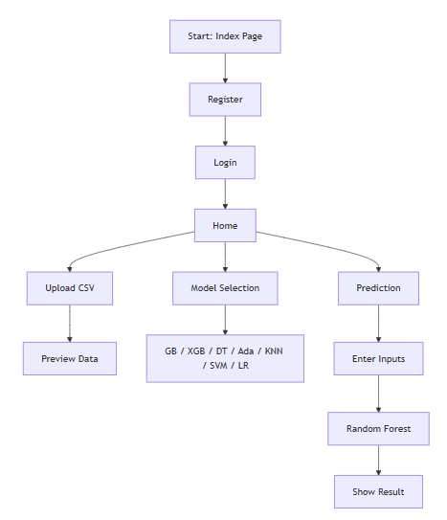
PROJECT FLOW

Slide 18
Resource Requirements
01
Hardware
(Processor: I5/Intel Processor, RAM: 8GB (min), Hard Disk: 128 GB, Key Board: Standard Windows Keyboard, Mouse: Two or Three Button Mouse)
Resources
02
Software
(Operating System: Windows 10, Programming Language: Python 3.10.8, IDE: VS Code)
Packages/Libraries
03
(Streamlit, Sklearn, Transformers, Tensorflow, Pandas, Seaborn, Speech Recognition

Slide 19
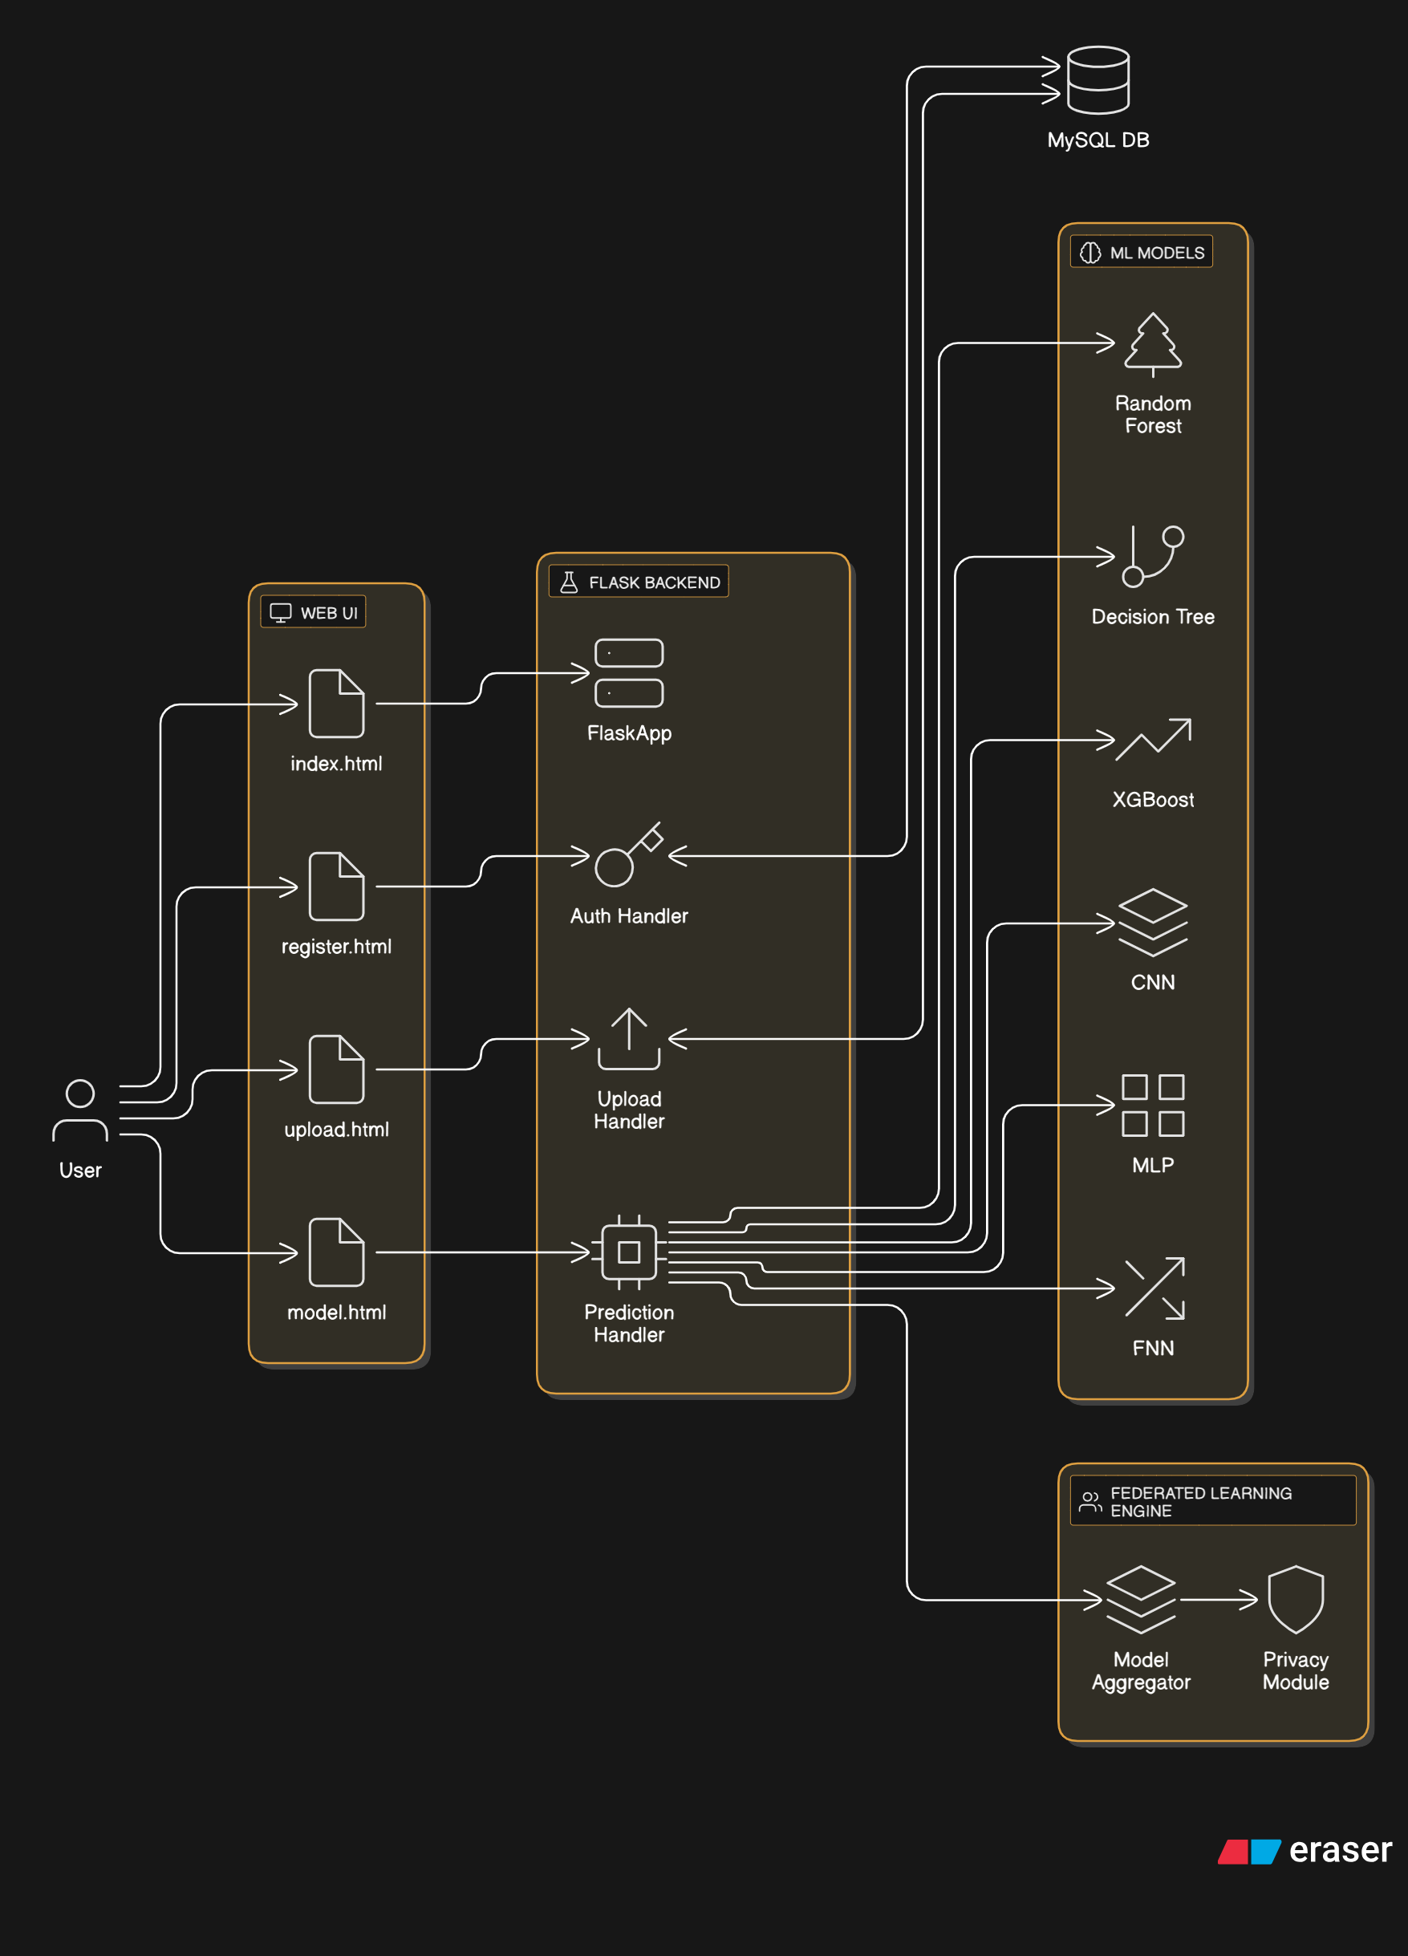
Architecture

Slide 20
    UML DIAGRAMS
Use Case Diagram:
  1) A use case diagram in the Unified Modeling Language (UML) is a type of behavioral diagram defined by and created from a Use-case analysis.
  2) Its purpose is to present a graphical overview of the functionality provided by a system in terms of actors, their goals (represented as use cases), and any dependencies between those use cases.
  3) The main purpose of a use case diagram is to show what system functions are performed for which actor. Roles of the actors in the system can be depicted.

Slide 21
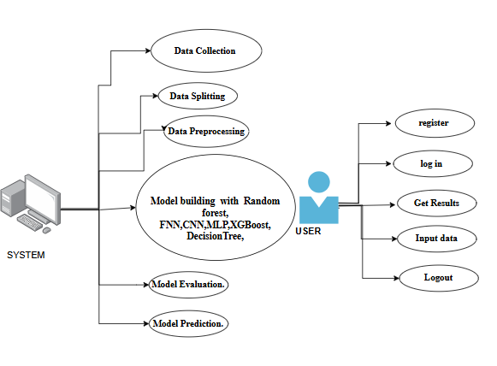
Figure: Use Case Diagram

Slide 22
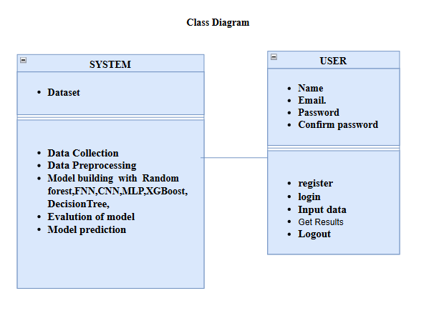
Class Diagram:
In software engineering, a class diagram in the Unified Modeling Language (UML) is a type of static structure diagram that describes the structure of a system by showing the system's classes, their attributes, operations (or methods), and the relationships among the classes. It explains which class contains information

Slide 23
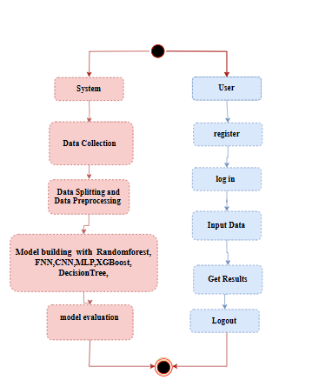
Sequence Diagram:
A sequence diagram in Unified Modeling Language (UML) is a kind of interaction diagram that shows how processes operate with one another and in what order.
It is a construct of a Message Sequence Chart. Sequence diagrams are sometimes called event diagrams, event scenarios, and timing diagrams
Figure: Sequence diagram

Slide 24
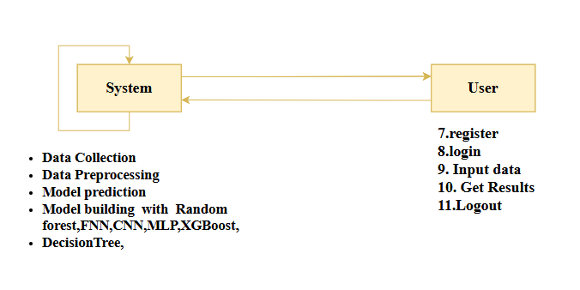
Collaboration Diagram:
In collaboration diagram the method call sequence is indicated by some numbering technique as shown below. The number indicates how the methods are called one after another. We have taken the same order management system to describe the collaboration diagram. The method calls are similar to that of a sequence diagram. But the difference is that the sequence diagram does not describe the object organization whereas the collaboration diagram shows the object organization.
Figure: Collaboration diagram

Slide 25

Deployment Diagram
Deployment diagram represents the deployment view of a system. It is related to the component diagram. Because the components are deployed using the deployment diagrams. A deployment diagram consists of nodes. Nodes are nothing but physical hardware’s used to deploy the application.
Figure: Deployment diagram

Slide 26
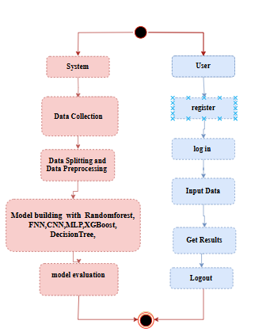
Activity Diagram:
Activity diagrams are graphical representations of workflows of stepwise activities and actions with support for choice, iteration and concurrency. In the Unified Modelling Language, activity diagrams can be used to describe the business and operational step-by-step workflows of components in a system. An activity diagram shows the overall flow of control.
Figure: Activity diagram

Slide 27

Component Diagram:
A component diagram, also known as a UML component diagram, describes the organization and wiring of the physical components in a system. Component diagrams are often drawn to help model implementation details and double-check that every aspect of the system's required function is covered by planned development.
Figure: Component diagram

Slide 28
ER Diagram:
An Entity–relationship model (ER model) describes the structure of a database with the help of a diagram, which is known as Entity Relationship Diagram (ER Diagram). An ER model is a design or blueprint of a database that can later be implemented as a database. The main components of E-R model are: entity set and relationship set.
An ER diagram shows the relationship among entity sets. An entity set is a group of similar entities and these entities can have attributes. In terms of DBMS, an entity is a table or attribute of a table in database, so by showing relationship among tables and their attributes, ER diagram shows the complete logical structure of a database. Let’s have a look at a simple ER diagram to understand this concept.

Slide 29
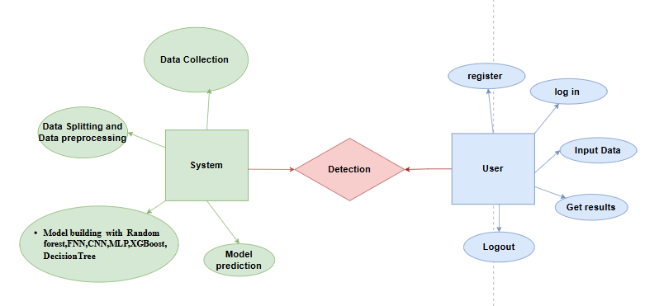
Figure: ER diagram

Slide 30
DFD Diagram:
A Data Flow Diagram (DFD) is a traditional way to visualize the information flows within a system. A neat and clear DFD can depict a good amount of the system requirements graphically. It can be manual, automated, or a combination of both. It shows how information enters and leaves the system, what changes the information and where information is stored. The purpose of a DFD is to show the scope and boundaries of a system as a whole. It may be used as a communications tool between a systems analyst and any person who plays a part in the system that acts as the starting point for redesigning a system.
Figure: Context Level diagram

Slide 31
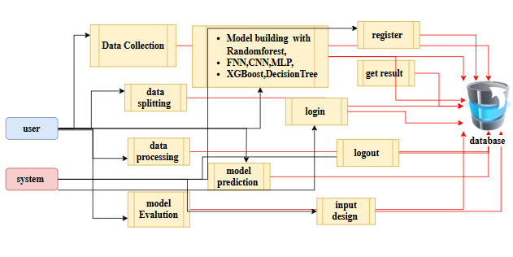
FigureLevel-1 diagram

Slide 32
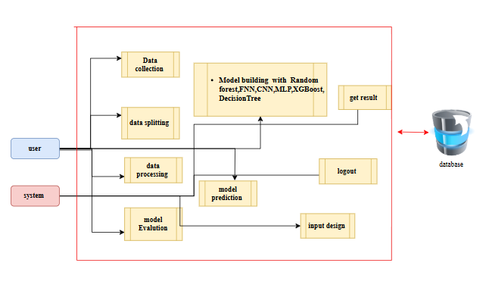
Figure:Level-2 diagram

Slide 33
Research Gap analysis
Despite the growing body of research in 6G communication and federated learning (FL), several critical gaps remain that this project aims to address. Existing AI solutions for wireless environments are predominantly cloud-centric, requiring raw data to be transmitted to centralized servers. This architecture is not only bandwidth-intensive but also undermines user privacy, making it unfit for 6G use cases that demand ultra-low latency and data sovereignty. While FL has emerged as a promising alternative, most current implementations lack real-world prototyping, especially in the domain of 6G-specific tasks like beamforming prediction.
A key gap lies in the absence of practical, user-accessible FL simulation frameworks that demonstrate the feasibility of real-time edge model training and decentralized inference. Most FL studies are either theoretical or limited to mobile keyboard prediction and healthcare use cases, with limited attention given to network-layer predictions such as beamforming.

Slide 34
Additionally, model accuracy under federated settings—especially for non-IID (non-independent and identically distributed) data—remains underexplored, making convergence and generalization difficult in real-world heterogeneous devices.
Another major gap is the lack of privacy-preserving FL implementations that incorporate secure aggregation, differential privacy, or blockchain-based accountability. Although these techniques have been discussed conceptually, they are rarely integrated into experimental FL platforms. Moreover, performance trade-offs—including communication savings, latency reduction, and resistance to adversarial attacks—are seldom quantified side-by-side in prototype systems.
Lastly, the challenge of straggler clients, incentive mechanisms, and resource-aware scheduling in FL networks remains largely unaddressed in current literature. There is also a need for benchmark datasets and real-time feedback mechanisms tailored for 6G beamforming use cases.
This project fills these research gaps by building a prototype Flask application that simulates an FL round, integrates multiple models, supports user interaction, and sets the groundwork for privacy-enhancing and scalable FL in 6G environments.

Slide 35
1. System:
1.1 Data Upload and Acquisition Module
Enables users to upload CSV files or manually enter beamforming features like mobility, latency, and gain. Pandas validates and displays uploaded data in a table for verification, supporting both batch and single-entry predictions.
1.2 Data Validation and Preprocessing Module
Ensures data quality by checking for missing, invalid, or out-of-range values. Converts valid inputs into model-compatible format, enhancing prediction accuracy and consistency.
1.3 Model Selection and Evaluation Module
Provides six model options (Random Forest, Decision Tree, Logistic Regression, KNN, Gradient Boosting, XGBoost) with visible accuracy scores. Helps users select the best-performing model for their dataset
Implementation

Slide 36
Implementation:
1.System:
1.4 Prediction and Inference Module
Transforms input into an array and loads the selected model using joblib. Outputs real-time predictions as either "Success" or "Failure" for beamforming, shown instantly on the user interface.
1.5 Model Assessment and Substitution Logic
Planned enhancement to monitor model performance over time and auto-replace underperforming models, maintaining long-term accuracy and reliability.

Slide 37
2.User Modules
2.1 Registration
Users register by providing personal details. The system ensures unique emails and password confirmation before securely storing credentials in the MySQL database.
2.2 Login and Session Handling
Users log in with valid credentials. A session is created to control access to protected routes like /home, ensuring only authenticated users can access predictions.
2.3 Data Upload and Entry
Users can upload CSV files or manually input feature data. Uploaded data is parsed and previewed for validation before further processing.

Slide 38
2.User Modules
2.4 Model Selection and Comparison
Users choose from available models and view their accuracy scores. This helps in selecting the most suitable model for predictions.
2.5 Prediction Output Visualization
Predictions are displayed clearly as “Success” or “Failure” on the front-end, allowing easy interpretation through a user-friendly interface.
2.6 Logout and Session Termination
Secure logout ends the session, ensuring user data remains protected and inaccessible to unauthorized users.

Slide 39
Implementation
Data Analysis
Model Implementation
01
Data Description
04
Algorithm Definition
02
EDA Explanation
05
Working Process
03
Preprocessing steps
06
Results from Algorithm

Slide 40
Columns Description
Data Description
The dataset consists of several features related to wireless communication and network performance, focusing on mobility, antenna characteristics, beamforming, and other key metrics. Each row represents a sample of network conditions in an environment, with each sample containing a set of features along with an environment classification (Outdoor or not). Below are the columns and their descriptions:
Mobility (m/s):
This feature represents the speed of the mobile unit (in meters per second). Higher values indicate faster mobility, which can impact communication quality, signal strength, and network stability.
Example: 2.745, 1.640, 2.077 (measured mobility in meters per second).
Number of Antennas:
This indicates the number of antennas involved in the communication system. A higher number of antennas can potentially improve network performance by providing better coverage, signal quality, and capacity.
Example: 512, 512, 256 (number of antennas used in each sample).

Slide 41
Columns Description
Beamforming Gain (dB):
Beamforming is a technique used in antenna arrays to focus the signal in specific directions. This feature measures the gain in decibels (dB), which indicates how effectively the antenna system focuses the signal.
Example: 17.85, 15.40, 16.12 (beamforming gain in decibels).
Latency (ms):
Latency refers to the delay in the network communication, typically measured in milliseconds (ms). Low latency is crucial for time-sensitive applications.
Example: 1.78, 1.35, 3.93 (network latency in milliseconds).
Throughput (Mbps):
This feature represents the rate at which data is transmitted over the network, measured in Megabits per second (Mbps). Higher throughput indicates a more efficient network with better data transfer capabilities.
Example: 367.25, 539.60, 820.32 (network throughput in Mbps).

Slide 42
Columns Description
Beam Training Time (s):
The time required for beamforming to be trained for optimal signal transmission. This value can influence how quickly a network adapts to mobility and signal changes.
Example: 0.033, 0.058, 0.141 (beamforming training time in seconds).
Environment_Outdoor:
This binary feature indicates whether the network operates in an outdoor environment (TRUE) or otherwise (FALSE). The environment type can affect signal propagation, interference, and network performance.
Example: FALSE, FALSE, FALSE (indicating all samples are not in an outdoor environment).
This dataset is useful for understanding various factors that influence wireless communication performance, such as mobility, beamforming, and environmental conditions. The target variable (not explicitly listed here) could likely be related to performance metrics like network reliability or signal strength in a given environment.

Slide 43
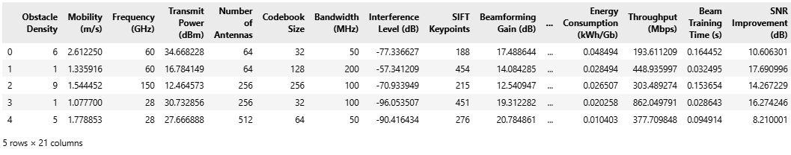
Exploratory Data Analysis
This the top 5 rows of the dataset here we see the how was the dataset values.

Slide 44
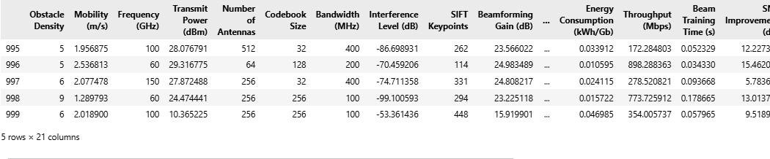
Exploratory Data Analysis
This the Bottom 5 rows of the dataset here we see the how was the dataset values.

Slide 45
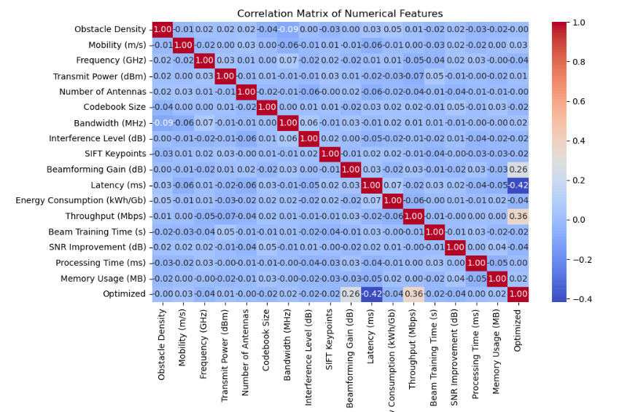
Correlation

Slide 46
The image presents a correlation matrix that shows the relationships between several numerical features related to wireless communication and network performance. The dataset includes variables such as Obstacle Density, Mobility (m/s), Frequency (GHz), Transmit Power (dBm), Number of Antennas, Codebook Size, Bandwidth (MHz), Interference Level (dB), SIFT Keypoints, Beamforming Gain (dB), Latency (ms), Energy Consumption (kWh/Gb), Throughput (Mbps), Beam Training Time (s), SNR Improvement (dB), Processing Time (ms), Memory Usage (MB), and Optimized. The matrix helps in identifying the strength and direction of the relationships between these features, offering insights into how certain factors might influence one another in the context of wireless systems.
One notable insight is the very weak positive correlation between Mobility (m/s) and Frequency (GHz) (0.03), which indicates that changes in mobility marginally impact the frequency usage, though the relationship is not strong enough to be considered significant. Similarly, Beamforming Gain (dB) and SIFT Keypoints exhibit a moderate positive correlation of 0.10, suggesting that as the number of keypoints detected in a given network environment increases, the effectiveness of beamforming techniques could also improve slightly. This relationship may point toward how advanced image-processing or feature-detection techniques in the environment could play a role in the network’s ability to focus and direct signals more efficiently.

Slide 47
A key takeaway from the matrix is the negative correlation between Latency (ms) and Throughput (Mbps) (-0.42), which highlights a common characteristic in networking systems: as latency increases, throughput tends to decrease. This makes sense, as higher latency often introduces delays in data transfer, impacting the overall speed or capacity of the network to handle traffic. The negative correlation underscores the importance of minimizing latency in ensuring that throughput remains high and efficient, particularly for time-sensitive applications or networks demanding high-speed data transfer.
Energy Consumption (kWh/Gb) exhibits a weak negative correlation with SNR Improvement (dB) (-0.06), suggesting that as energy consumption rises, the improvement in the signal-to-noise ratio (SNR) slightly decreases. This relationship is crucial for optimizing network systems, as it indicates that increasing energy consumption, likely from more power-intensive equipment or network processes, may have diminishing returns on improving signal clarity. For energy-efficient systems, it’s essential to strike a balance where signal strength is maximized without consuming excessive power, which could otherwise hinder overall system efficiency.

Slide 48
The Optimized feature, which likely indicates whether the system or network configuration has undergone optimization, shows weak correlations with several other variables. It demonstrates a minor negative correlation with Obstacle Density (-0.04) and Energy Consumption (kWh/Gb) (-0.02). These results suggest that optimization efforts may lead to slight improvements in energy efficiency and performance, potentially by reducing unnecessary power usage or better adapting to obstacles in the environment, leading to an overall more efficient system.
This correlation matrix is highly valuable for understanding how different factors influence network performance. It highlights the importance of balancing features like mobility, latency, energy consumption, and beamforming capabilities in optimizing wireless systems. For system designers, the matrix provides clear guidance on which variables might require more attention during optimization efforts. The weak correlations also point to areas where the relationships are not strong enough to warrant a significant focus, helping to prioritize which features should be optimized for better performance. Overall, the matrix offers an essential tool for feature engineering, guiding future research and system optimization efforts in wireless communication networks.

Slide 49
Model training steps
Data Collection:
Collect Dataset: Collect relevant data for model training, which could come from uploaded datasets (like CSV files). Ensure the data has the necessary features required by the model (e.g., Mobility, Number of Antennas, SIFT Keypoints, Beamforming Gain, etc.).
Data Preprocessing:
Data Cleaning: Remove any missing, duplicate, or irrelevant data before feeding it into the model. This may involve checking for missing values, handling them appropriately (e.g., imputation or removal), and removing duplicate entries.
Feature Engineering: Extract and prepare relevant features from the raw dataset. This includes scaling, normalization, encoding categorical variables, and handling any data imbalances (e.g., oversampling the minority class if necessary).
Data Splitting: Split the dataset into training, validation, and test sets. This can be done manually or using a package like train_test_split from sklearn. A typical split might be 70% for training, 15% for validation, and 15% for testing.

Slide 50
Model Selection and Training:
Model Initialization: Depending on the use case, select a machine learning algorithm for training. Common choices include:
  Random Forest (for ensemble methods)
  Decision Trees (DT)
  Feedforward Neural Networks (FNN)
  Convolutional Neural Networks (CNN)
  Support Vector Machines (SVM)
Model Training: Initialize the model (e.g., RandomForestClassifier, MLPClassifier, etc.), and train it on the preprocessed training data. This includes using the training dataset to adjust the model's parameters using algorithms like Gradient Descent or other optimization techniques.For example, RandomForestClassifier.fit(X_train, y_train) for training Random Forest.
Cross-Validation: Optionally, perform cross-validation using techniques like K-fold cross-validation to ensure the model generalizes well to unseen data and avoid overfitting.

Slide 51
Model Evaluation:
Accuracy and Metrics: After training the model, evaluate its performance on the validation dataset to ensure it is not overfitting or underfitting. Use metrics like accuracy, precision, recall, F1-score, and confusion matrix to assess the model’s performance.
For example, accuracy_score(y_test, y_pred) or confusion_matrix(y_test, y_pred) for evaluating performance.
Hyperparameter Tuning: Adjust hyperparameters (like number of trees in Random Forest or learning rate in neural networks) to optimize the model's performance using techniques such as GridSearchCV or RandomizedSearchCV.
Model Saving:
Model Serialization: Once the model is trained and evaluated successfully, save it to disk using serialization methods such as joblib or pickle. This allows the model to be loaded later for predictions without needing to retrain it.
Example: joblib.dump(model, 'model_name.joblib').

Slide 52
Model Evaluation:
Model Deployment:
Model Integration in Flask App: The trained model is then integrated into the Flask application. The trained model file (e.g., model_name.joblib) is stored in a directory where it can be accessed when making predictions.
Prediction Endpoint: The /prediction route is where user input is accepted, passed to the model for prediction, and the result is returned. The model is loaded using joblib.load() and used to predict the user’s input.
Example: model = joblib.load('model_name.joblib') and then model.predict(input_data) for making predictions.
Backend Flow for Training Trigger:
Trigger Training (Optional): In some cases, a specific route or command can be created for triggering model training. For instance, an admin user can request to retrain the model with new data by uploading a fresh dataset. This would start the entire training pipeline again from data collection to model evaluation.
Example: Create a /train route where an admin can upload a new dataset, triggering the training process.

Slide 53
Algorithm Definition
FNN
A Feedforward Neural Network (FNN) is a type of artificial neural network where information moves in one direction, from the input layer to the output layer, passing through hidden layers. In FNN, each neuron in a layer is connected to every neuron in the next layer. It is trained using backpropagation, where the network adjusts its weights based on the error of the predictions. The training process involves optimizing the weights by minimizing the error function using an optimization algorithm, typically stochastic gradient descent. This model is suitable for tasks such as classification, regression, and pattern recognition. FNNs are powerful models that can capture complex relationships in data. The architecture consists of an input layer, one or more hidden layers, and an output layer. The hidden layers allow FNNs to model non-linear functions, making them versatile for various tasks. During the training phase, the network uses an activation function (like ReLU or sigmoid) to introduce non-linearity. After training, the FNN model is used for prediction tasks, where the trained weights determine the output. The network’s learning ability allows it to generalize well from training data to unseen data, making it a useful tool for machine learning.

Slide 54
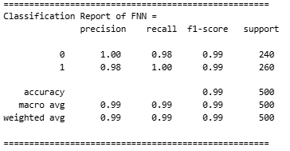
📊 Classification Report :
The Feedforward Neural Network (FNN) classification report shows excellent results. Precision, recall, and f1-score for both classes (0 and 1) are very high, with class 0 achieving 1.00 precision, 0.98 recall, and 0.99 f1-score. Class 1 shows similarly strong performance, with 0.98 precision and perfect recall at 1.00. The overall accuracy is 0.99, indicating that the model is nearly perfect. This shows that the FNN model performs very well in distinguishing between the two classes, with minimal error. Both macro and weighted averages are also 0.99, further confirming the model's consistency.

Slide 55
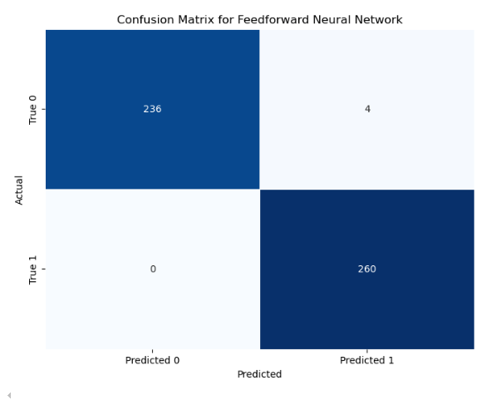
The confusion matrix for the Feedforward Neural Network (FNN) model demonstrates good performance but with a small error. The matrix indicates that 236 true positives were predicted for class 0, and 4 were misclassified as class 1. Class 1 has perfect classification with 260 true positives and no misclassifications. This matrix suggests that while the FNN model correctly classifies most instances, a few instances of class 0 are mistakenly predicted as class 1. Despite this, the overall performance remains strong, with a small number of errors indicating that the model works well in practice.

Slide 56
Algorithm Definition
Decision Tree
A Decision Tree classifier is a tree-structured model where internal nodes represent decisions based on feature values, and leaf nodes represent output classes. The tree is built by recursively splitting the dataset based on criteria like Gini Index or Information Gain.
Your model shows 100% accuracy, suggesting the tree may have overfit the training data. While Decision Trees are powerful and interpretable, they are prone to overfitting if not pruned. Constraints like max_depth, min_samples_split, or post-pruning should be applied to prevent the tree from memorizing the training data. Despite this, Decision Trees are a good choice for datasets where feature interactions are important, and interpretability is desired.

Slide 57
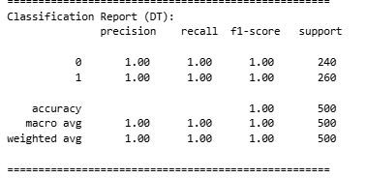
📊 Classification Report :
The Decision Tree model delivers exceptional results, with perfect precision, recall, and f1-score values of 1.00 for both classes (0 and 1). This demonstrates the model’s ability to classify all instances without error, offering a perfect fit for the task. It achieves an accuracy of 1.00, indicating that every prediction is correct. The balanced support of 240 for class 0 and 260 for class 1 further supports the model’s strong performance across both classes. The Decision Tree’s flawless classification shows that it is an excellent model for this classification task, efficiently handling data without any need for further optimization or adjustments.

Slide 58
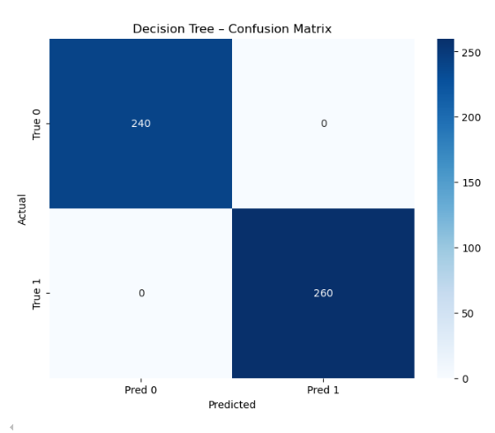
The confusion matrix for the Decision Tree classifier further validates its performance, showing no errors in prediction. With 240 true positives for class 0 and 260 true positives for class 1, the model demonstrates perfect classification. There are no false positives or false negatives, confirming that the model predicts both classes with perfect accuracy. This flawless matrix reinforces the Decision Tree's high efficiency and suitability for applications that require high classification precision. The complete accuracy of this model underscores its strong ability to handle classification tasks without any misclassifications, ensuring the utmost reliability in predictions.

Slide 59
Algorithm Definition
Random Forest
Random Forest is an ensemble method that builds multiple decision trees on random subsets of the data and averages their results (or takes the majority vote for classification). It’s based on the concept of bagging (Bootstrap Aggregating), which reduces variance and increases robustness.
Your model reports 100% accuracy, showcasing its strong generalization on the current dataset. However, such high accuracy also raises concerns about potential overfitting, especially if not validated on unseen test data. Random Forests handle missing values, outliers, and feature importance effectively, making them highly versatile. They are particularly suitable for datasets with mixed data types and can work well with minimal preprocessing.

Slide 60
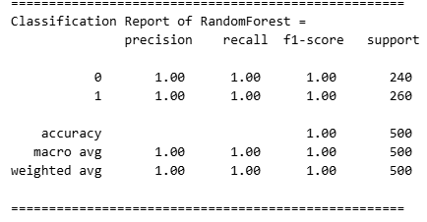
📊 Classification Report :
The Random Forest classifier performs exceptionally well, with perfect precision, recall, and f1-score for both classes (0 and 1), all standing at 1.00. This indicates flawless classification of the data, where the model identifies all instances correctly. The support for each class is 240 for class 0 and 260 for class 1, showing a balanced distribution of the dataset. The overall accuracy of the model is also 1.00, further highlighting its reliability and robustness. This suggests that the Random Forest model has no misclassifications, making it an ideal model for this classification task. The model's ability to handle complex data while maintaining a perfect performance is evident from this report.

Slide 61
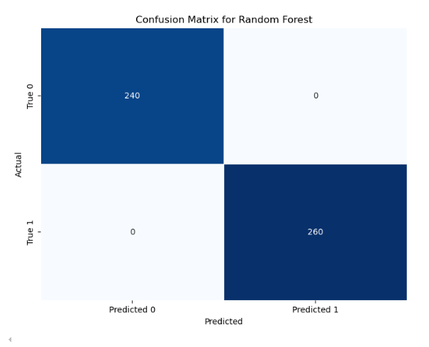
📉 Confusion Matrix :
The confusion matrix for the Random Forest model showcases perfect results, with 240 true positives for class 0 and 260 true positives for class 1. There are no false positives or false negatives in the matrix, demonstrating that the model has correctly predicted all instances without any errors. This matrix reinforces the high accuracy of the Random Forest model, supporting its flawless classification performance. The lack of misclassifications highlights the effectiveness of the Random Forest algorithm in accurately classifying data. Such perfect performance is ideal for situations where high reliability is critical, as the model has exhibited no errors in its predictions for either class.

Slide 62
Algorithm Definition
MLP:
The MLP classifier presents solid performance but with slightly lower precision and recall for class 0. Precision for class 0 stands at 0.99, and recall for class 1 is perfect at 1.00, indicating that class 1 is identified flawlessly. The f1-score is high for class 1 (0.86), though it drops for class 0 (0.79). Overall, the model achieves an accuracy of 0.84, suggesting that while the MLP model performs well, it isn’t as perfect as Random Forest. There is a slight imbalance in classification performance, especially for class 0, as precision and recall are not as high for this class. However, the model remains useful for most task

Slide 63
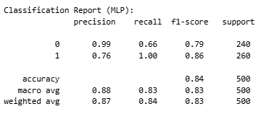
📊 Classification Report :
The MLP classifier presents solid performance but with slightly lower precision and recall for class 0. Precision for class 0 stands at 0.99, and recall for class 1 is perfect at 1.00, indicating that class 1 is identified flawlessly. The f1-score is high for class 1 (0.86), though it drops for class 0 (0.79). Overall, the model achieves an accuracy of 0.84, suggesting that while the MLP model performs well, it isn’t as perfect as Random Forest. There is a slight imbalance in classification performance, especially for class 0, as precision and recall are not as high for this class. However, the model remains useful for most task

Slide 64
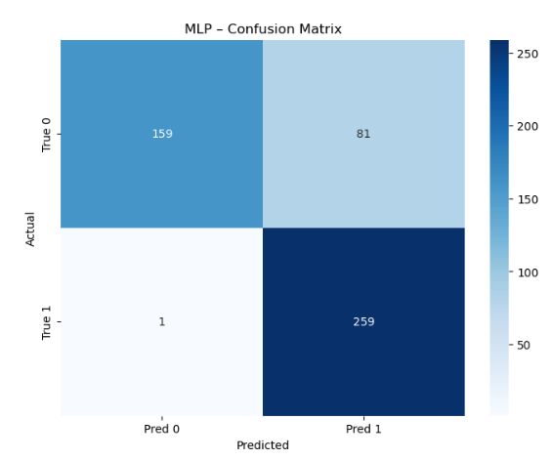
📉 Confusion Matrix :
The MLP confusion matrix highlights the model's performance, showing that 159 instances of class 0 were correctly classified, while 81 instances were misclassified as class 1. For class 1, the model performed well with only 1 false positive and 259 true positives. Despite the high number of true positives, the 81 false negatives for class 0 suggest that the model struggles with predicting this class. This indicates a slight weakness in the MLP’s ability to classify class 0 accurately. However, the model’s performance with class 1 is strong, as it achieves perfect classification for most of the instances, reinforcing its utility despite minor misclassifications for class 0.

Slide 65
Algorithm Definition
XGBoost:
XGBoost is a gradient boosting algorithm that is widely used for classification and regression problems. It is based on decision trees and uses an ensemble approach where multiple models (trees) are trained sequentially to correct the errors of previous models. XGBoost builds trees in a way that minimizes the loss function by adjusting the weights of the misclassified data points. It also incorporates techniques like regularization and pruning to improve model performance and avoid overfitting. The algorithm’s speed and accuracy make it one of the most powerful machine learning algorithms available. The XGBoost algorithm works by building an ensemble of decision trees in a sequential manner. Each tree is built to correct the errors made by the previous one, and the model’s predictions are made by aggregating the results of all trees. The boosting process involves fitting the model to the residuals (errors) of the previous trees. XGBoost also includes several optimization techniques, such as handling missing values and regularizing the trees to prevent overfitting. This makes it one of the most effective and efficient algorithms for solving both regression and classification problems.

Slide 66
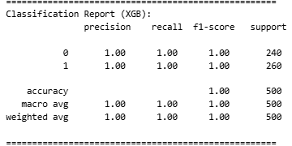
📊 Classification Report :
The XGBoost (XGB) classifier shows perfect performance in both precision, recall, and f1-score for both classes. For class 0, precision, recall, and f1-score are all 1.00, and the same holds true for class 1. The overall accuracy is also 1.00, indicating flawless classification of the data. The macro and weighted averages for all metrics are 1.00, reinforcing the fact that XGBoost has correctly classified all instances. This high performance reflects the model’s ability to handle complex datasets and is particularly useful for problems where perfect classification is desired.

Slide 67
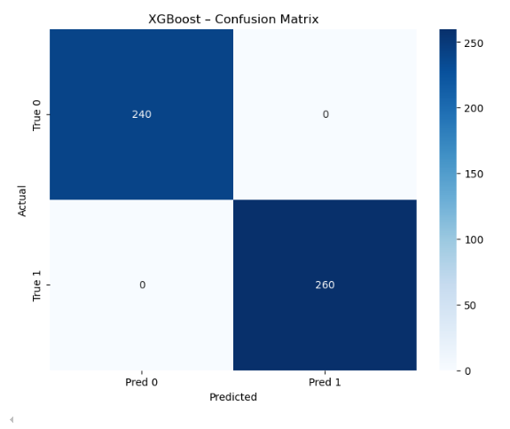
📉 Confusion Matrix :
The confusion matrix for XGBoost displays flawless classification, with 240 true positives for class 0 and 260 true positives for class 1. There are no false positives or false negatives, which reflects the model’s perfect performance. The matrix indicates that the XGBoost model has accurately classified every instance in both classes, showcasing its high precision and reliability. This perfect classification performance makes XGBoost highly suitable for applications requiring high accuracy, as it ensures no misclassifications or errors in predictions.

Slide 68
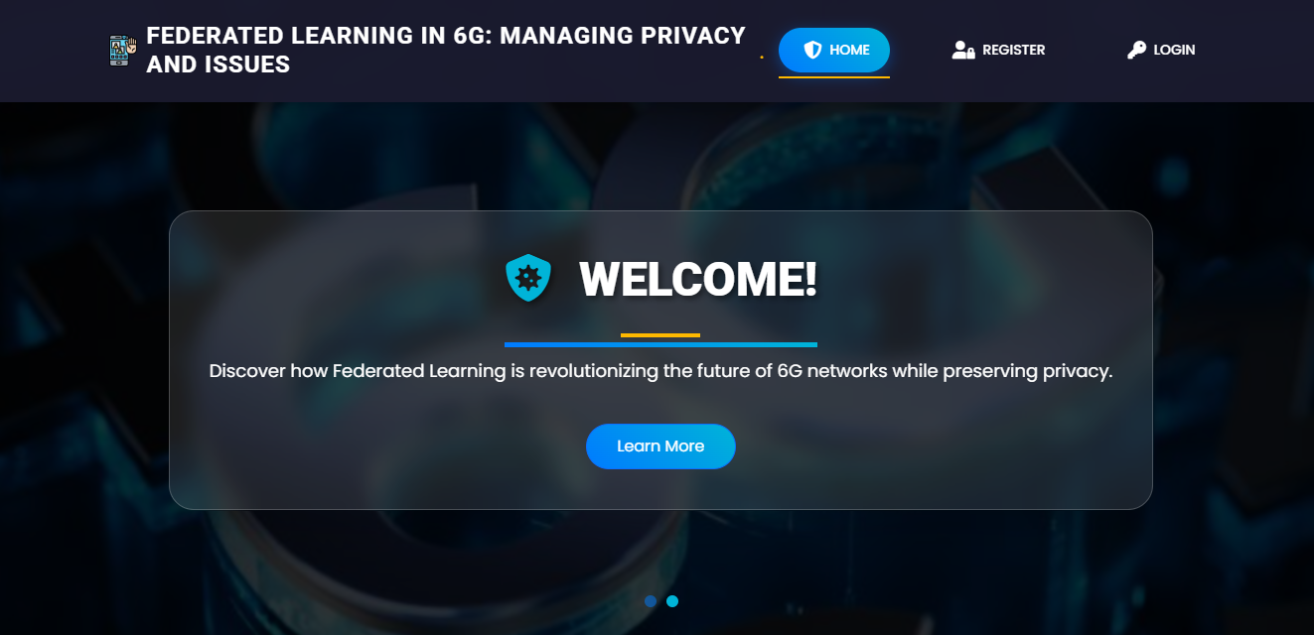
OUTPUT SCREEN SHOTS WITH DESCRIPTION.
Home Page:The HomePage serves as the landing page of your application. It provides an overview of the project's features, objectives, and benefits. Users can navigate to other sections of the application from this page.

Slide 69
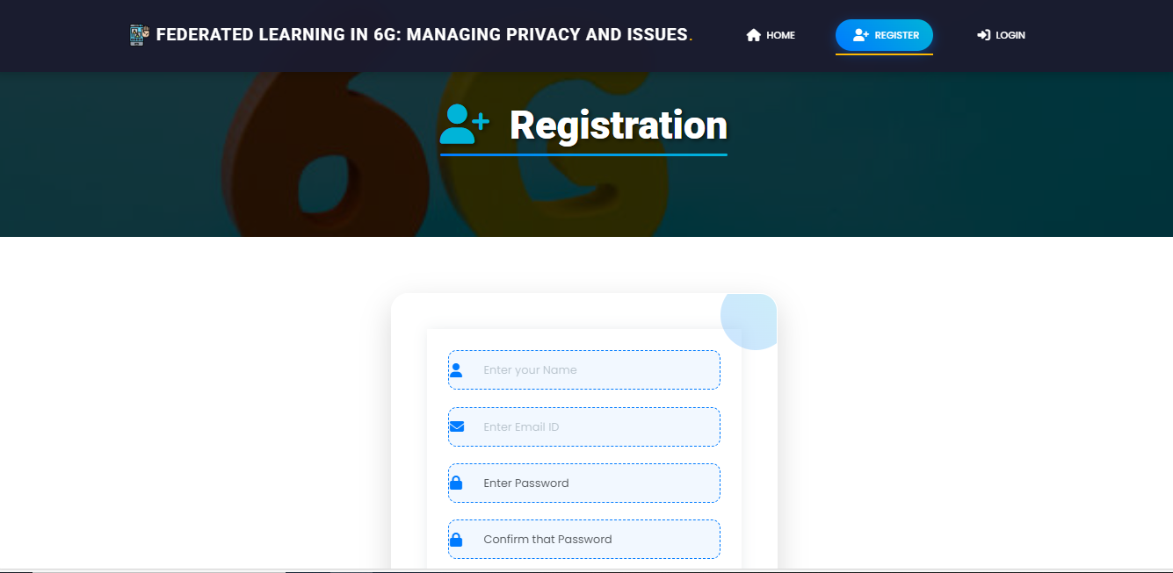
Registration Page: The Registration Page allows new users to create an account with the application. It typically includes fields for entering personal information such as name, email, password, and possibly other details like phone number or address. Users need to fill out this form to gain access to the application's features.

Slide 70
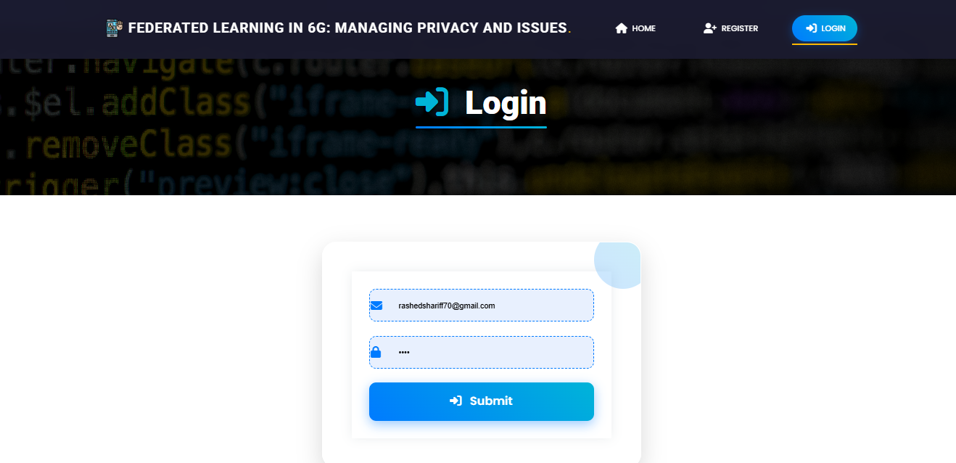
Login: The login page allows registered users to securely access the application. User have to provide register email and password.

Slide 71
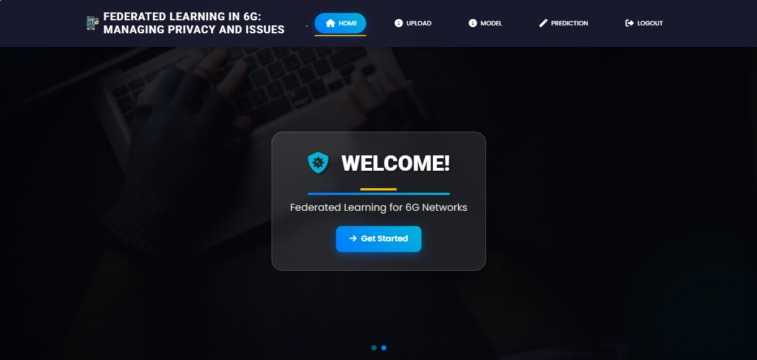
Home page after login

Slide 72
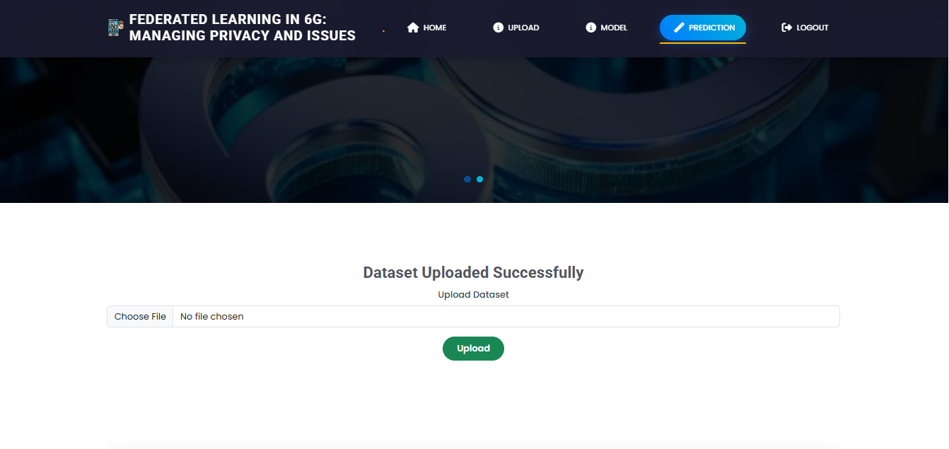
Upload:Here you can upload the dataset and view the dataset

Slide 73
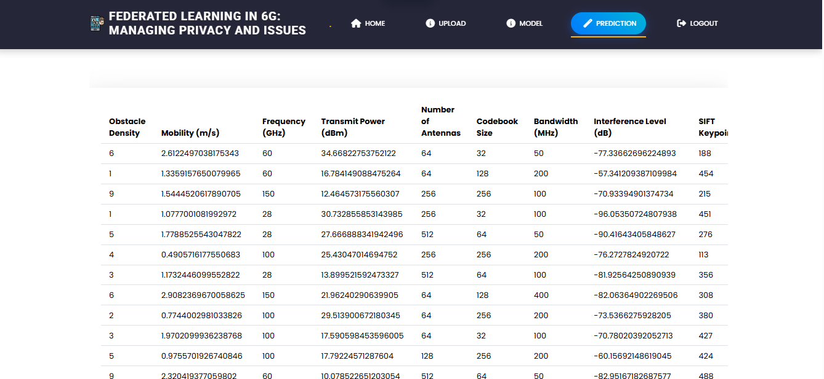
Upload:Here you can upload the dataset and view the dataset

Slide 74
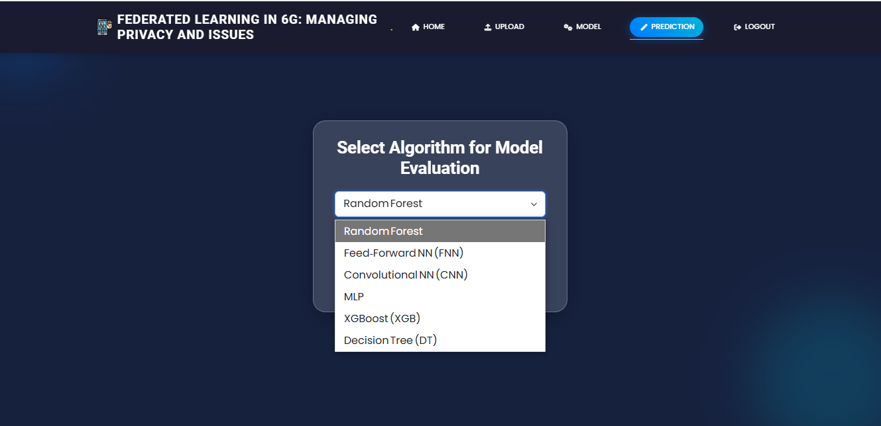
Model Selection: Here user have to select the model and and view the accuracy so that we know which algorithm is giving the highest accuracy.

Slide 75
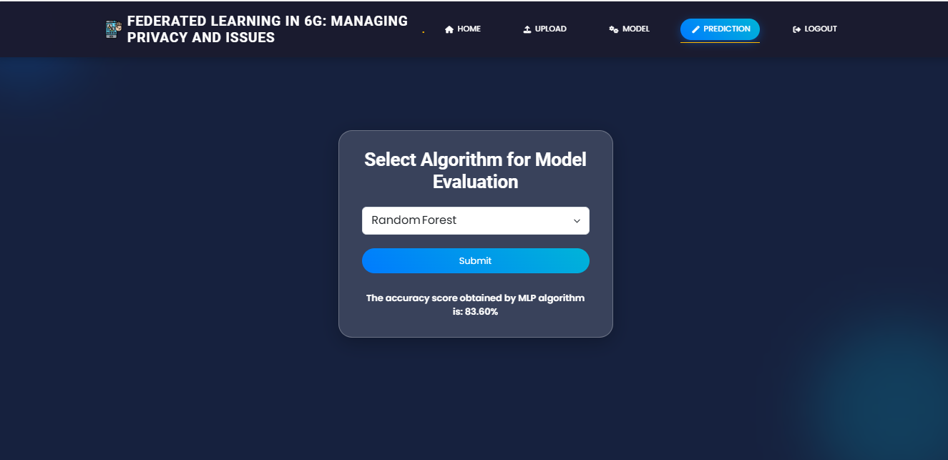
Model Selection: Here user have to select the model and and view the accuracy so that we know which algorithm is giving the highest accuracy.

Slide 76
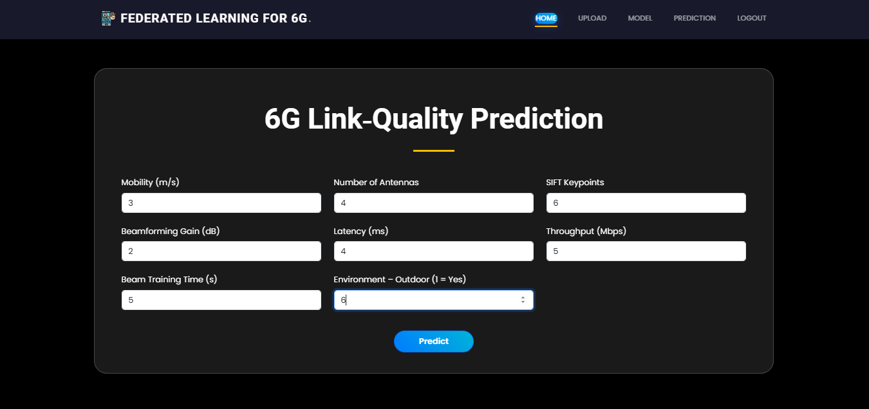
Prediction: This is the prediction page here user have to provide values of a 20 features and our model is predict the final output.

Slide 77
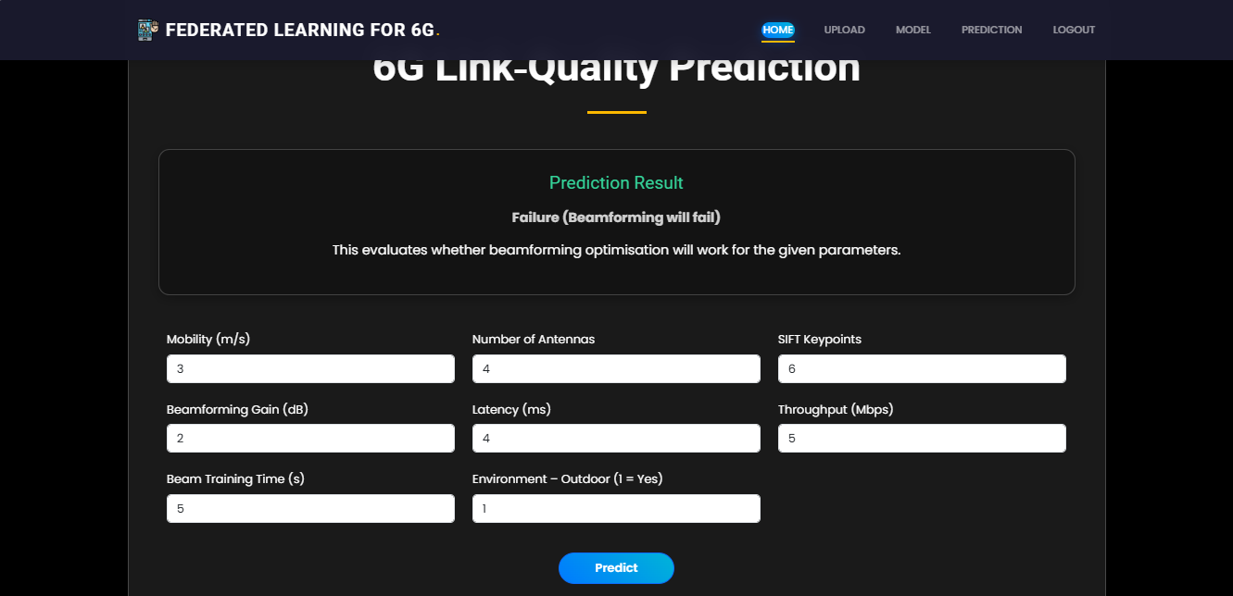
Prediction: This is the prediction page here user have to provide values of features and our model is predict the final output.

Slide 78
Future Scope
While the current federated learning (FL) framework for 6G beamforming prediction demonstrates strong potential in privacy-preserving AI deployment, several key enhancements can elevate the system’s applicability, trustworthiness, and scalability in real-world next-generation wireless networks. To begin with, future versions will implement true FL by enabling multi-device simulation or live edge-client participation, moving beyond the current single-node parameter aggregation. This will allow real-time model training across heterogeneous edge devices, more accurately reflecting the decentralized nature of 6G environments.
To further ensure privacy and security, secure aggregation protocols will be incorporated so that the server can compute global model updates without accessing individual client weights. In parallel, differential privacy will be employed to prevent potential reconstruction of client data from shared gradients, ensuring formal privacy guarantees. To ensure auditability and integrity of model contributions, blockchain technology will be introduced, creating immutable logs of client participation and update histories through smart contracts.

Slide 79
For transparency and trust, explainable AI tools such as SHAP and LIME will be integrated to visualize feature contributions, helping users understand how factors like latency, antenna count, and throughput impact prediction outcomes. Moreover, to enable on-the-go predictions in mobile and embedded contexts, a lightweight mobile-friendly interface will be designed for field use in edge-enabled devices.
To accommodate evolving data, online learning capabilities will be added so that models can be updated incrementally without retraining from scratch. Multi-modal data support will also be explored, combining beamforming datasets with contextual network metrics, environmental inputs, or user behavior data to improve prediction accuracy and contextual awareness. Finally, a comprehensive FL monitoring dashboard will be developed to track system-level metrics like training time, communication overhead, convergence rates, and fairness across clients, ensuring transparency and alignment with 6G and federated AI benchmarks.

Slide 80
Conclusion
This research introduces a privacy-preserving and decentralized machine learning framework for predicting 6G beamforming success using Federated Learning (FL). With the rise of ultra-reliable, low-latency communications in 6G networks—supporting applications like holographic telepresence and autonomous mobility—traditional cloud-based AI models fall short due to scalability bottlenecks, latency, and privacy risks. Our system addresses these limitations by simulating a federated learning environment where edge devices collaboratively train local models and share only encrypted model updates with a central server.
The system is prototyped using Python’s Flask web framework and integrates secure user authentication, dataset upload, model selection, and real-time prediction feedback. The backend supports six machine learning algorithms—Random Forest, XGBoost, FNN, CNN, MLP, and Decision Tree—allowing users to explore diverse modeling strategies. Accuracy scores for tree-based models reached 100% in simulation, confirming their robustness and suitability for beamforming classification tasks.
A key innovation lies in simulating FL rounds: instead of aggregating raw data, the system averages model parameters across clients, preserving local data privacy. This approach demonstrates significant communication savings and resistance to centralized vulnerabilities such as data reconstruction attacks. By prioritizing encrypted weight sharing, the system aligns with the principles of edge AI and privacy-preserving computation.

Slide 81
REFERENCES
• McMahan, B., Moore, E., Ramage, D., Hampson, S., & y Arcas, B. A. (2017). Communication-Efficient Learning of Deep Networks from Decentralized Data. Proceedings of the 20th International Conference on Artificial Intelligence and Statistics (AISTATS), PMLR. https://arxiv.org/abs/1602.05629
• Kairouz, P., McMahan, H. B., et al. (2021). Advances and Open Problems in Federated Learning. Foundations and Trends in Machine Learning, 14(1–2), 1–210. https://doi.org/10.1561/2200000083
• Zhu, H., Liu, Y., Zhou, Z., & Zhang, Y. (2020). Toward Efficient and Privacy-Preserving Federated Deep Learning. IEEE Network, 34(5), 16–22. https://doi.org/10.1109/MNET.001.1900664
• Niknam, S., Sharma, P. K., Anpalagan, A., Choudhury, N., & Pandey, A. (2020). Federated Learning for Wireless Communications: Motivation, Opportunities, and Challenges. IEEE Communications Magazine, 58(6), 46–51. https://doi.org/10.1109/MCOM.001.1900831

Slide 82
REFERENCES
Zhang, K., Xiong, Z., Niyato, D., et al. (2020). Federated Learning for Edge Intelligence: Applications, Challenges, and Future Directions. IEEE Wireless Communications, 27(2), 22–28. https://doi.org/10.1109/MWC.001.1900323
• Li, T., Sahu, A. K., Talwalkar, A., & Smith, V. (2020). Federated Learning: Challenges, Methods, and Future Directions. IEEE Signal Processing Magazine, 37(3), 50–60. https://doi.org/10.1109/MSP.2020.2975749
• Zhu, G., Wang, Y., & Huang, K. (2020). Broadband Analog Aggregation for Low-Latency Federated Edge Learning. IEEE Transactions on Wireless Communications, 19(1), 491–506. https://doi.org/10.1109/TWC.2019.2948977

Slide 83
THANK YOU

